Slide 1
poised for growth
West Virginia Brewing Industry
BrilliantStream.com

Slide 2
National Big Picture
WV Brewing Industry
5,500 breweries, up from under 100 in late 1970s
Growth in a competitive, maturing marketplace
Large breweries squeezed by small ones
Microbreweries with taprooms most successful
Craft volume up 6% in 2016.
Dollar share of craft up to 21.9% of beer market in 2016

Slide 3
Small & independent Breweries GROWING
WV Brewing Industry
Local is still in. Consumers want it.
Innovation in brewing and beer styles
Growing customer interest creates upside
More focus on quality, variety that consumer wants
Price increases lead to more profitability
Community leaders love them

Slide 4
MicroBreweries with Taprooms
WV Brewing Industry
The best business model for small brewery
Smaller investment, higher profitability
Model helps accelerate distribution potential
Small, nimble, innovative. Can move with market
Not traditional restaurants. Emphasize beer not food.
Taprooms attract families, tourists, anchor redevelopment
Compatible with commercial-industrial & downtowns

Slide 5
WV CRAFT Brewery History
WV Brewing Industry
1991 – Legislature adopts Brewpub Law
1992 – 1st new generation brewpub opens
2009 – Only 5 breweries • Alcohol cap raised
Today – 27 breweries
12 new ones in 2016 and 2017

Slide 6
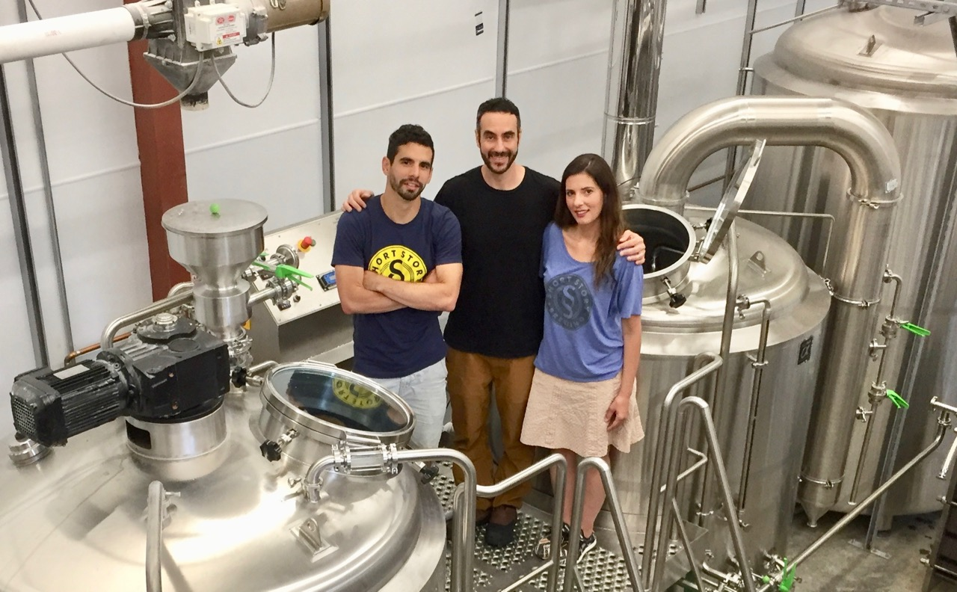
Short Story brewing

Slide 7
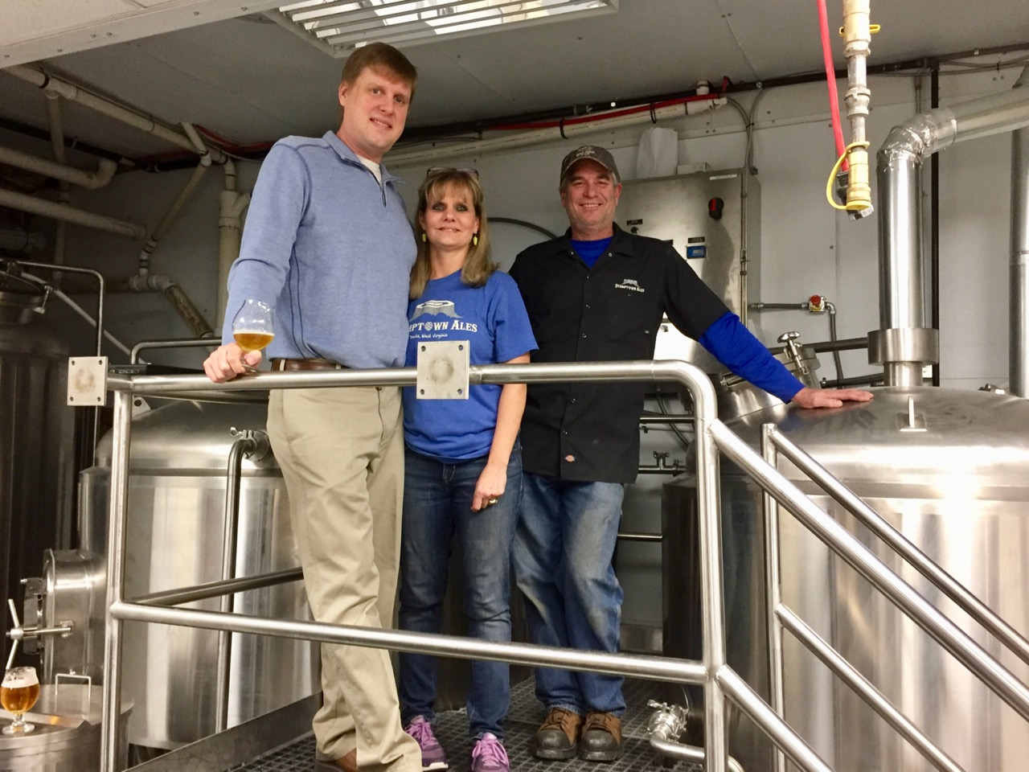
Stumptown Ales

Slide 8
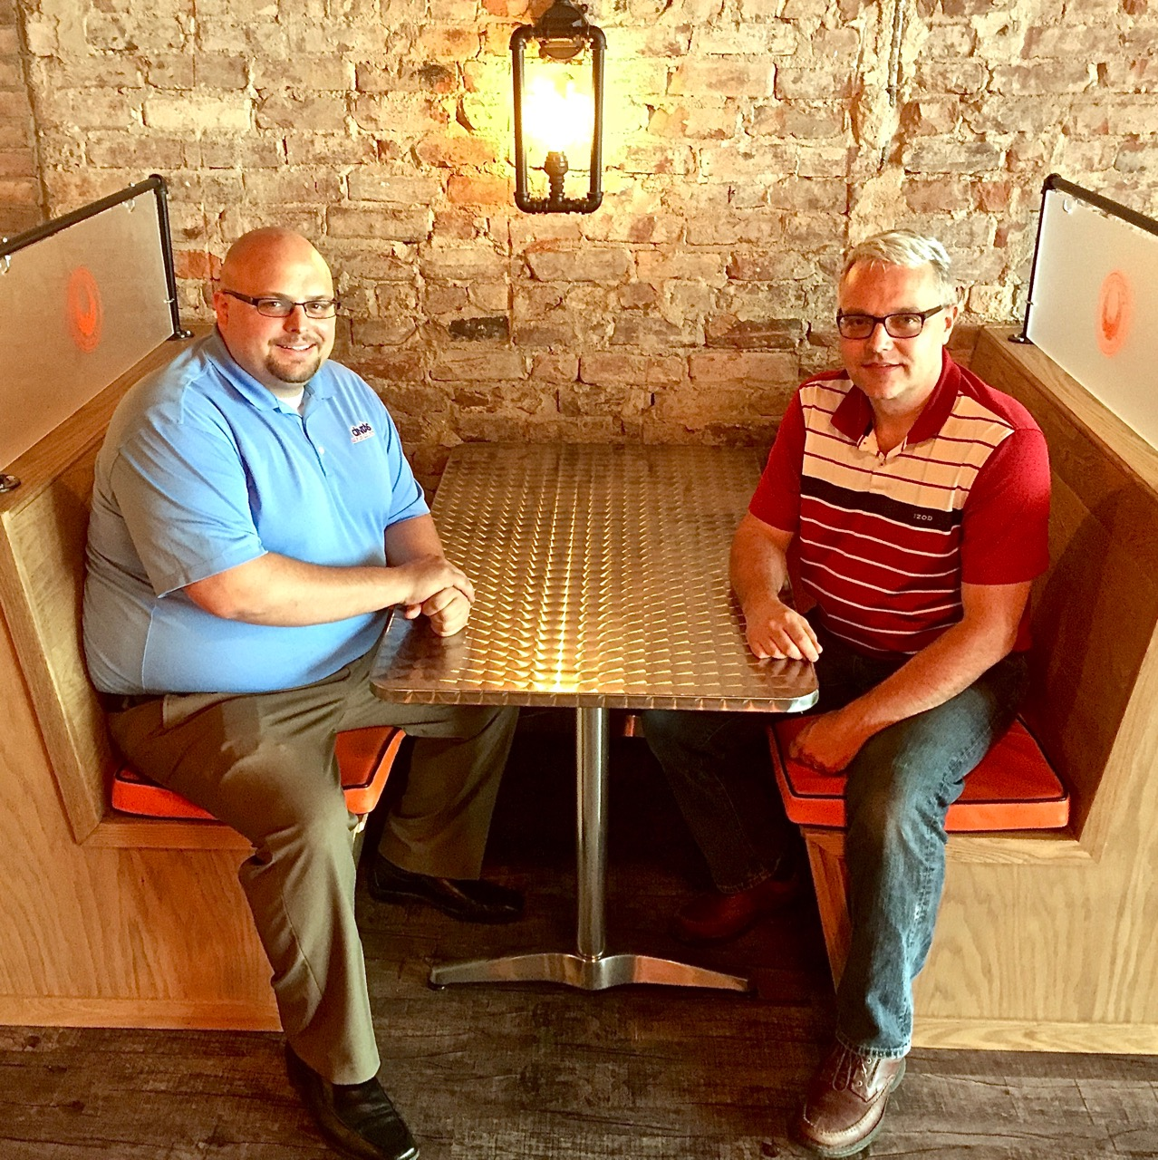
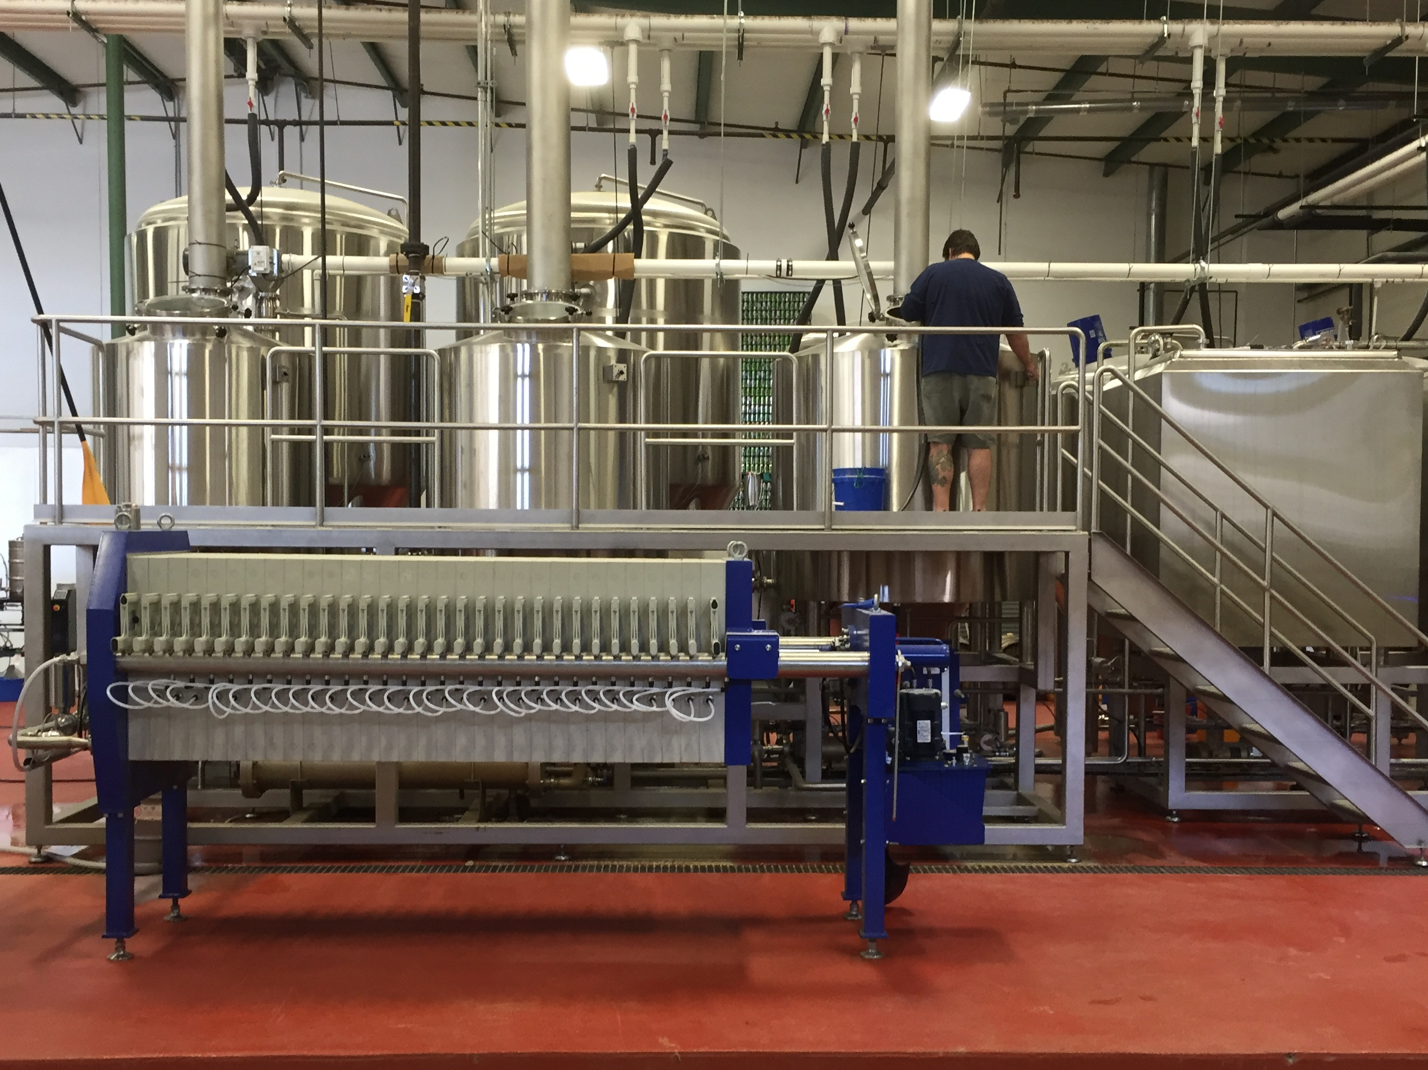
Greenbrier Valley Brewing

Slide 9
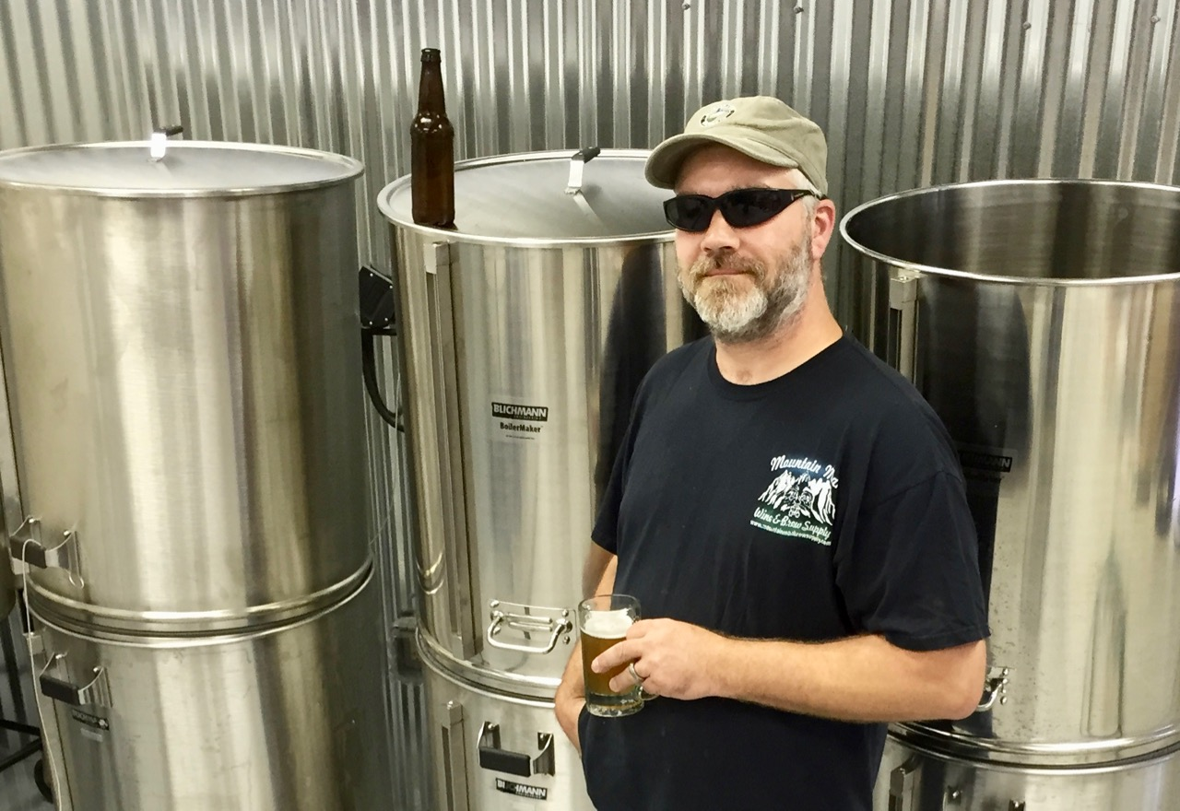
Berkeley Springs Brewing
Text

Slide 10
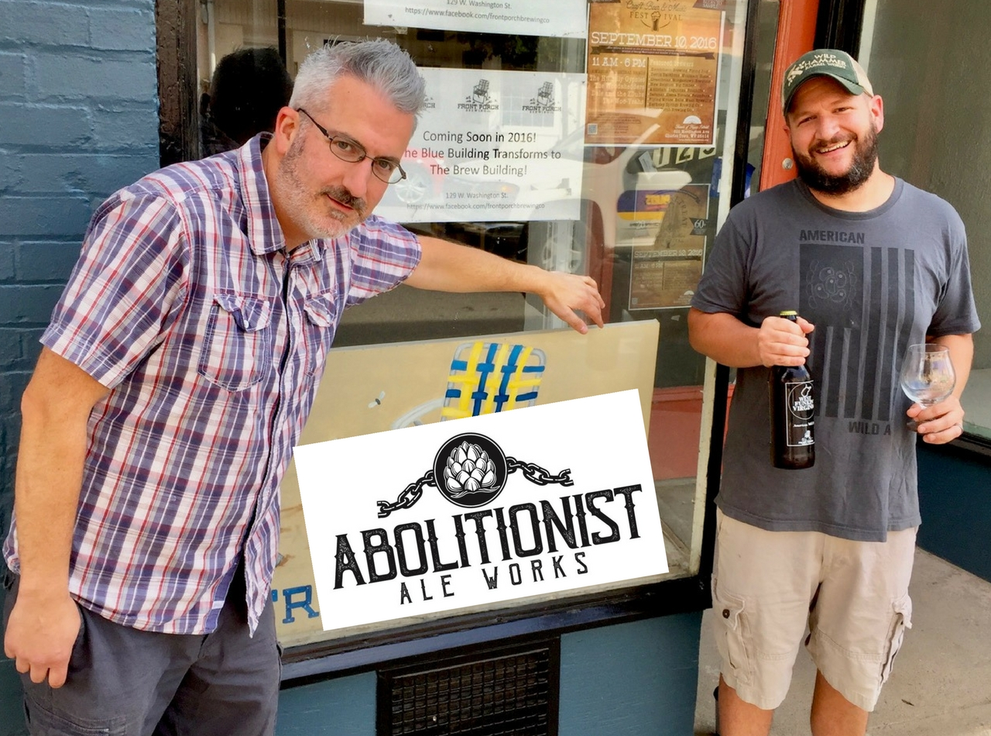
Text

Slide 11
Parkersburg Brewing

Slide 12
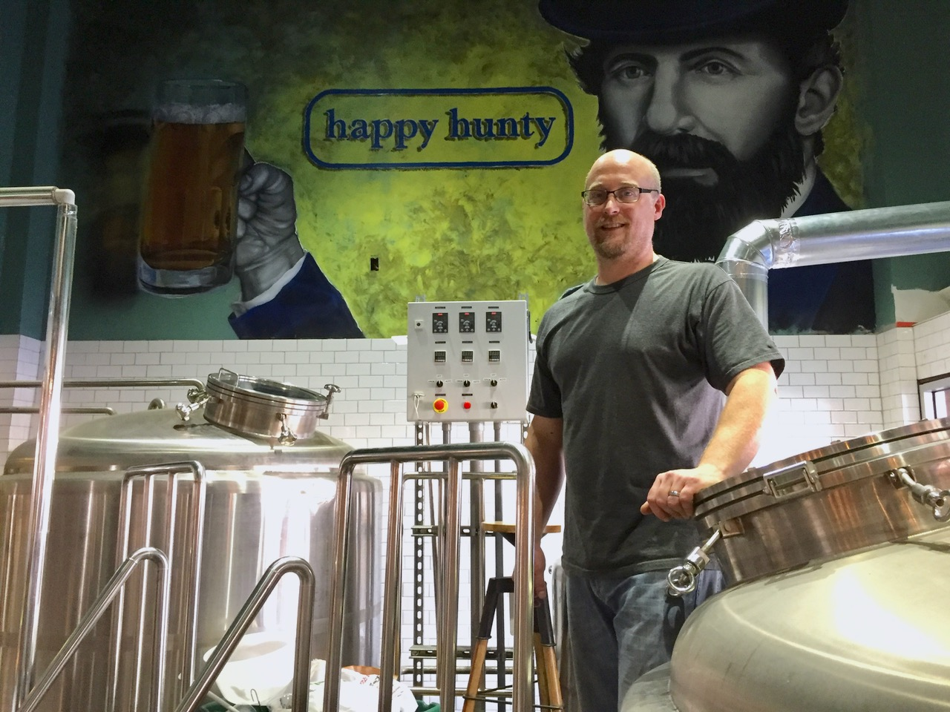
The Peddler Brewpub

Slide 13
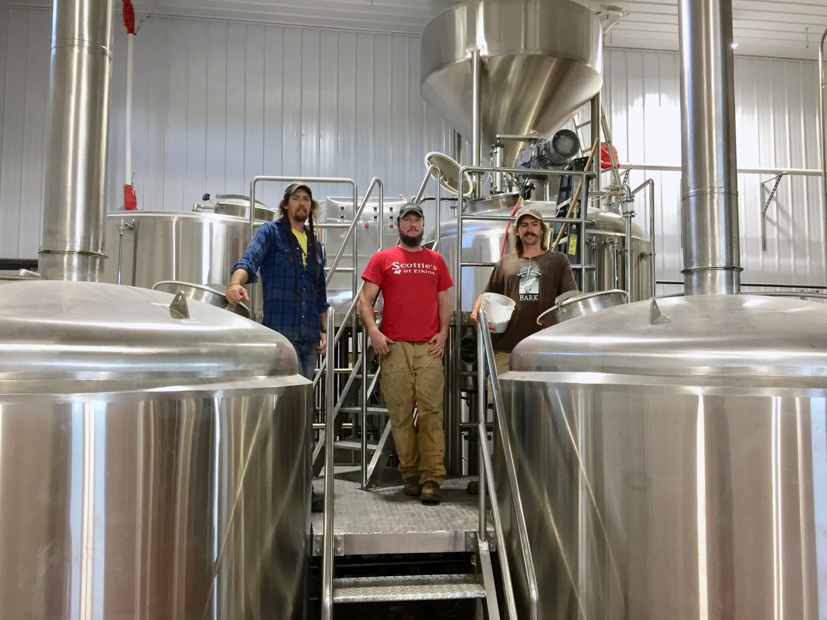
Mountain State Brewing

Slide 14
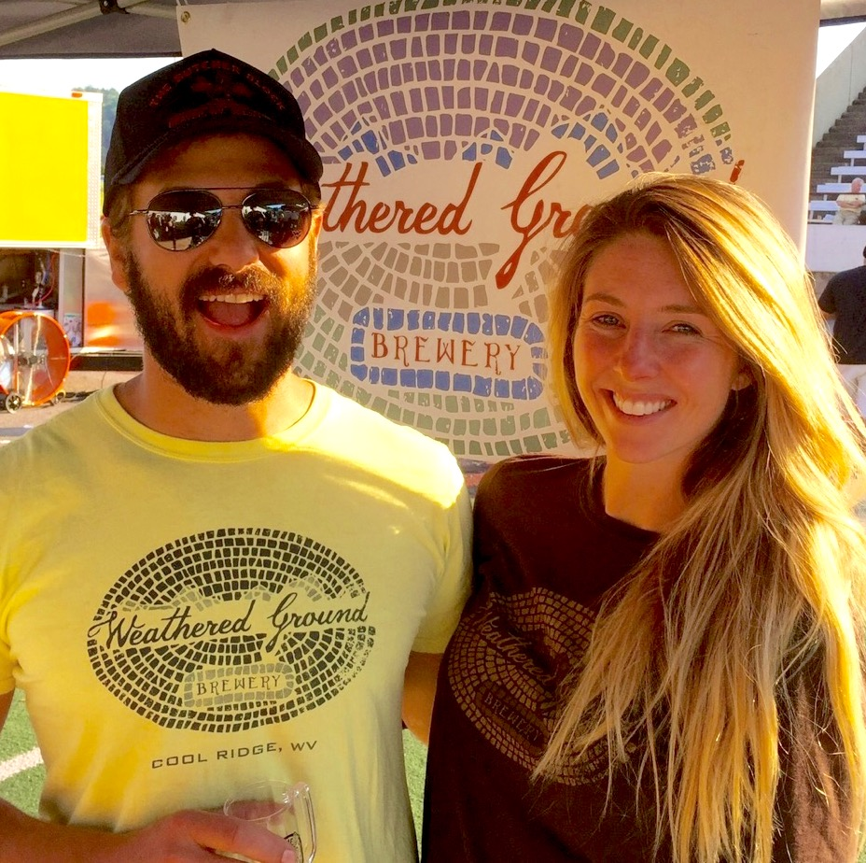
Sam & Aryn Fonda • Weathered Ground Brewery

Slide 15
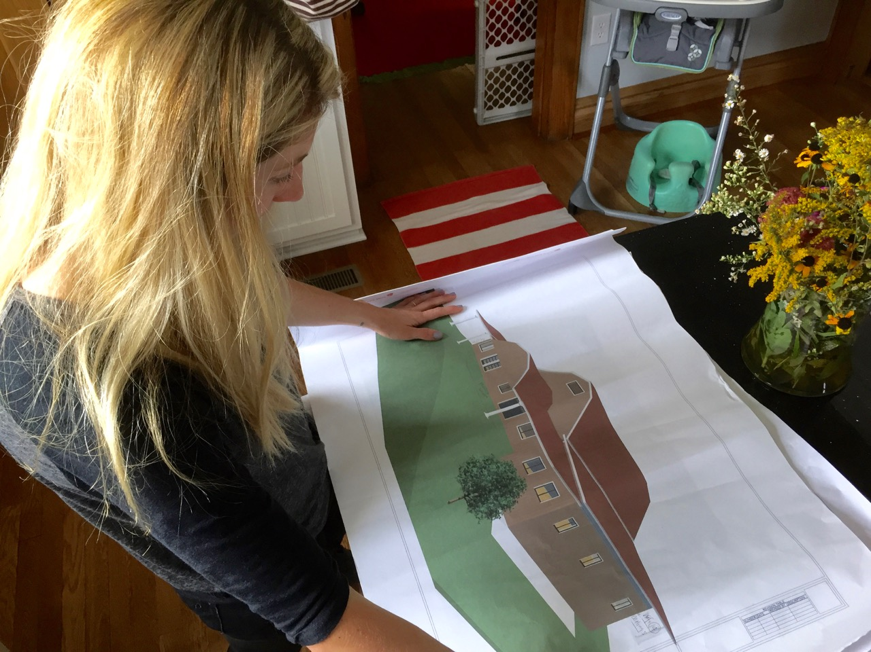
Weathered Ground Brewery

Slide 16
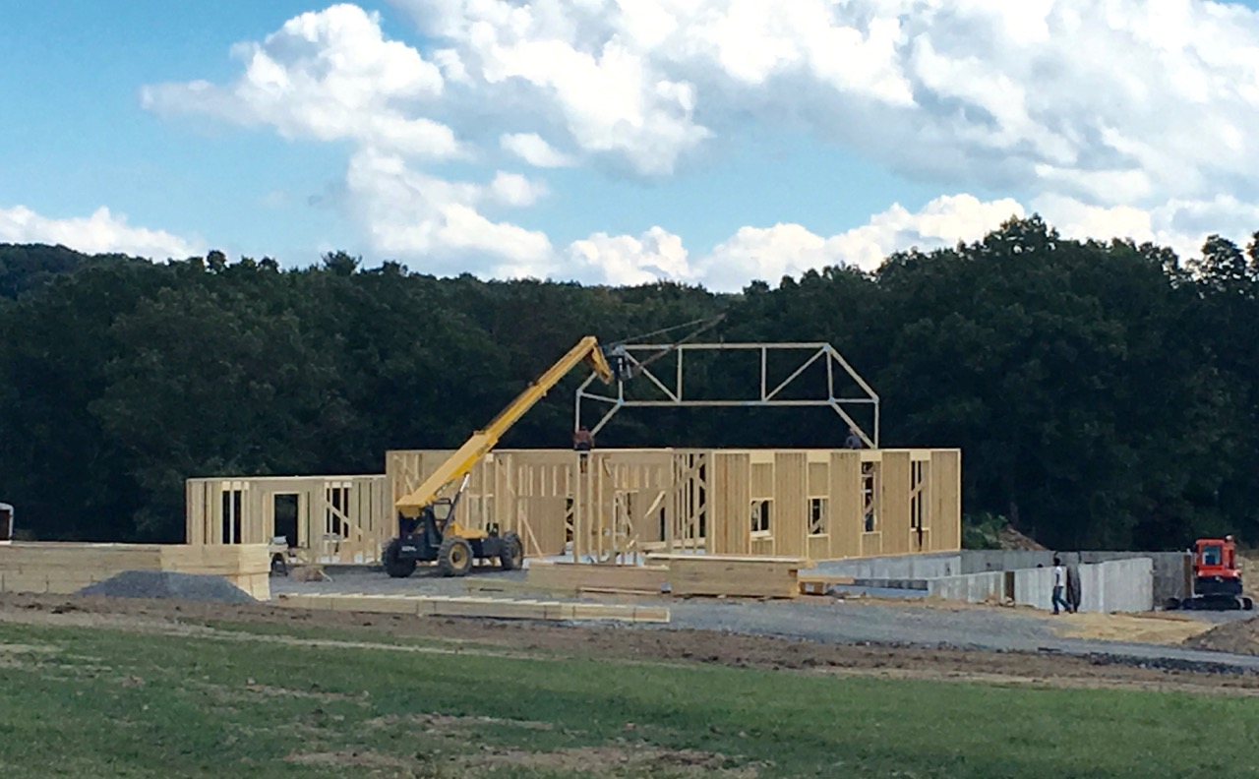
Weathered Ground Brewery

Slide 17
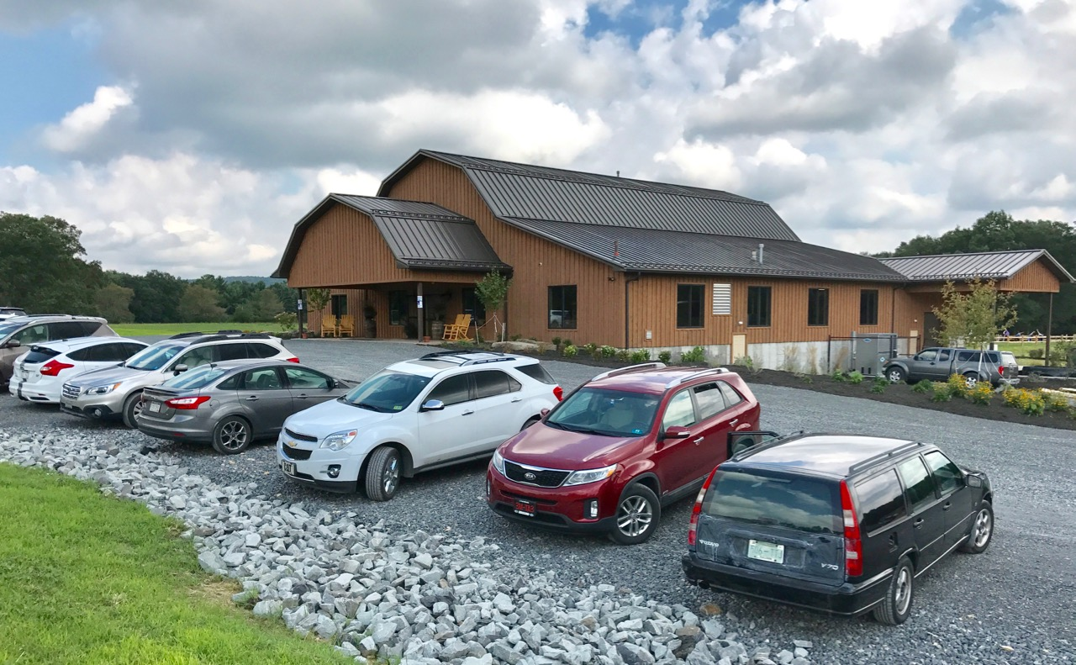
Weathered Ground Brewery

Slide 18
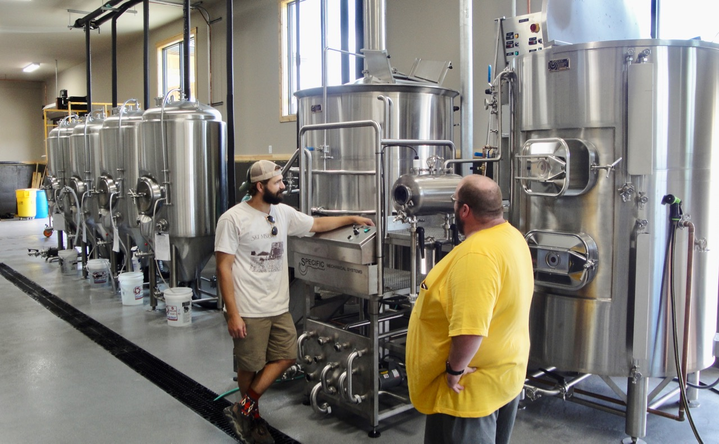
Weathered Ground Brewery

Slide 19
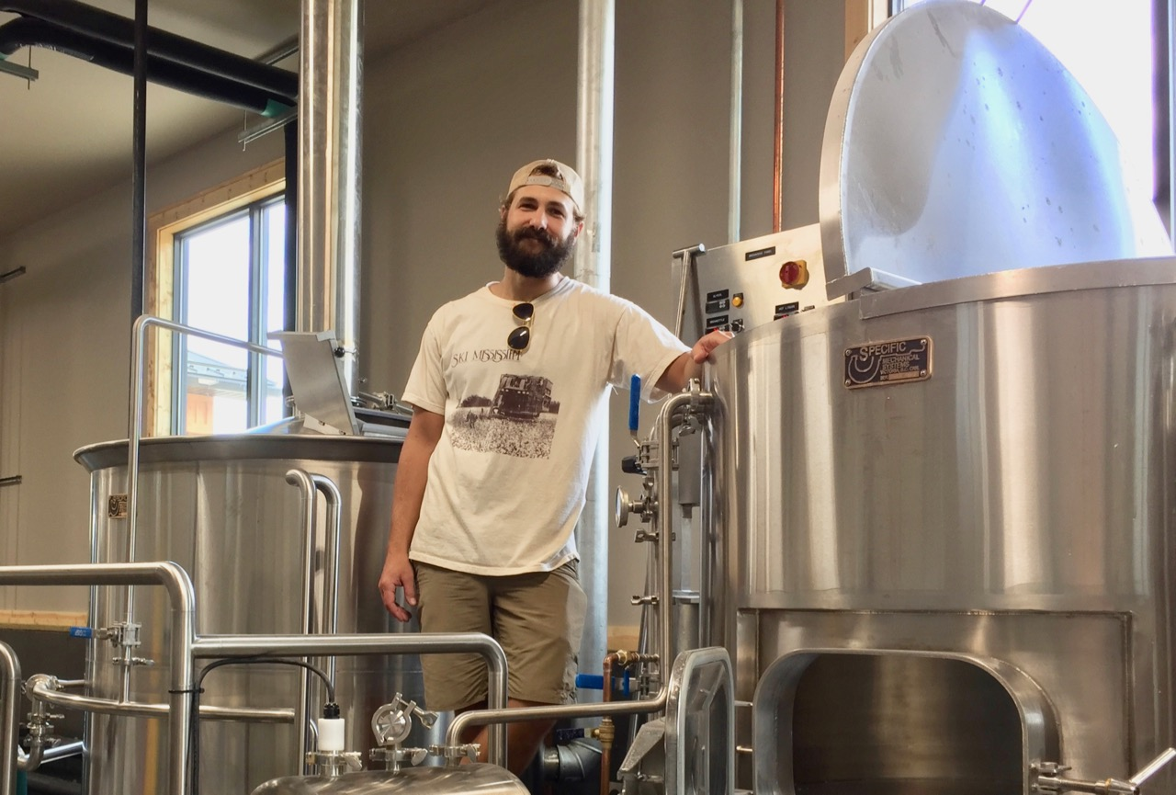
Weathered Ground Brewery

Slide 20
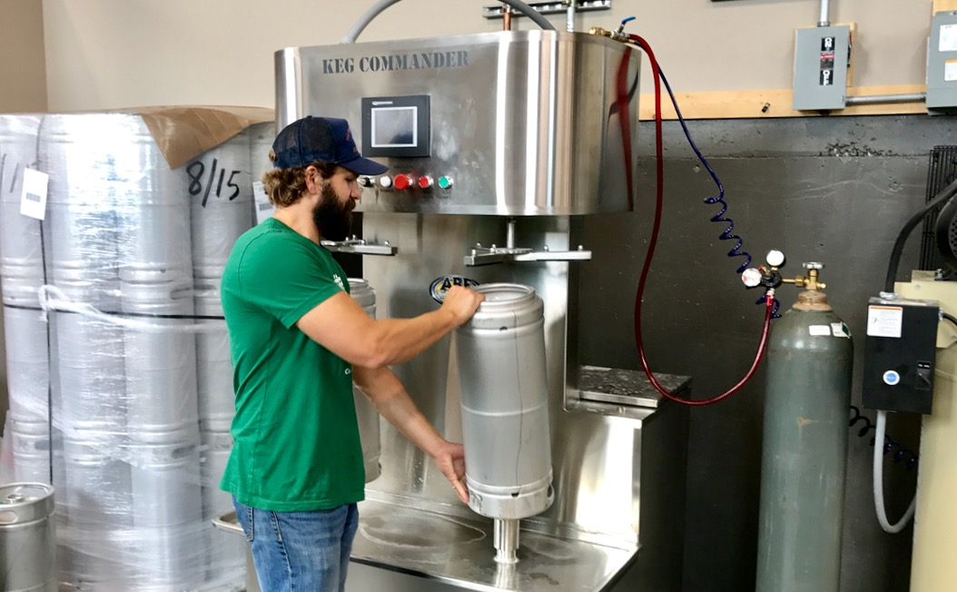
Weathered Ground Brewery

Slide 21
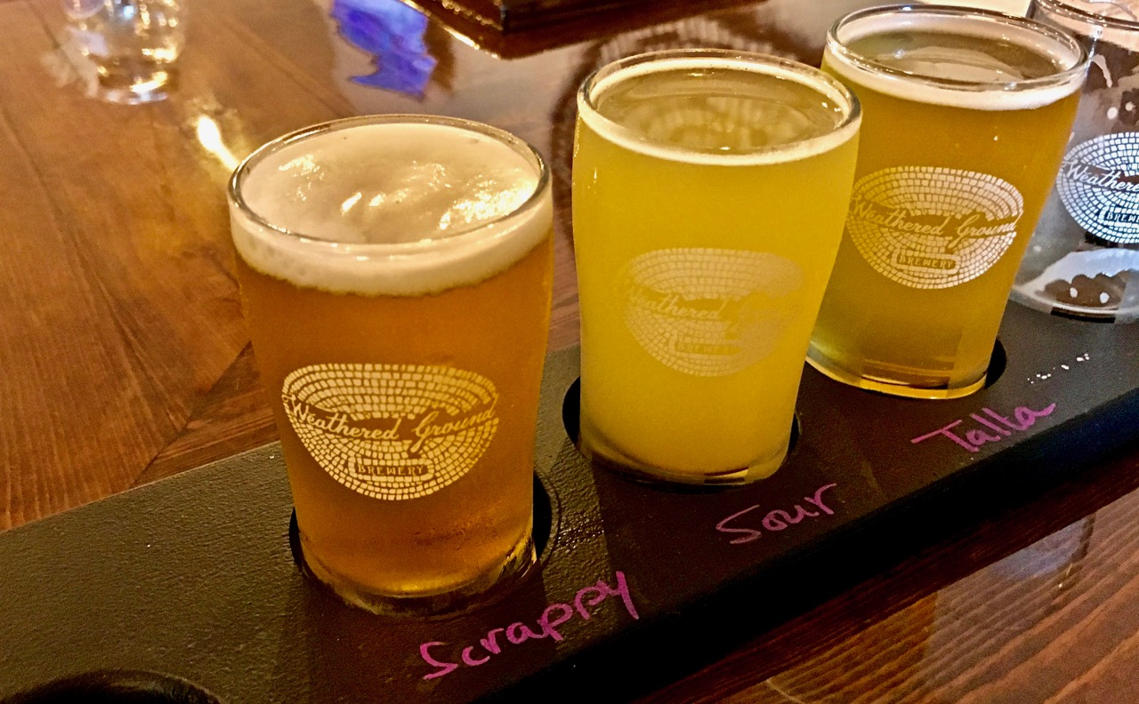
weathered ground Brewery

Slide 22
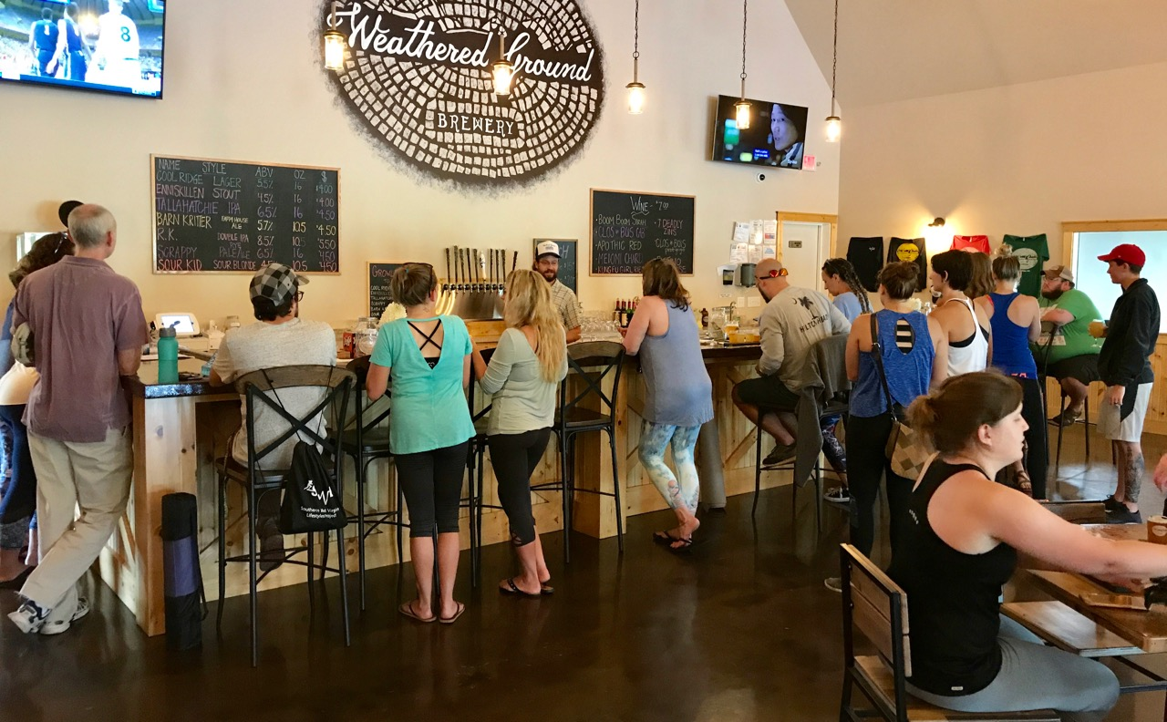
Weathered Ground Brewery

Slide 23
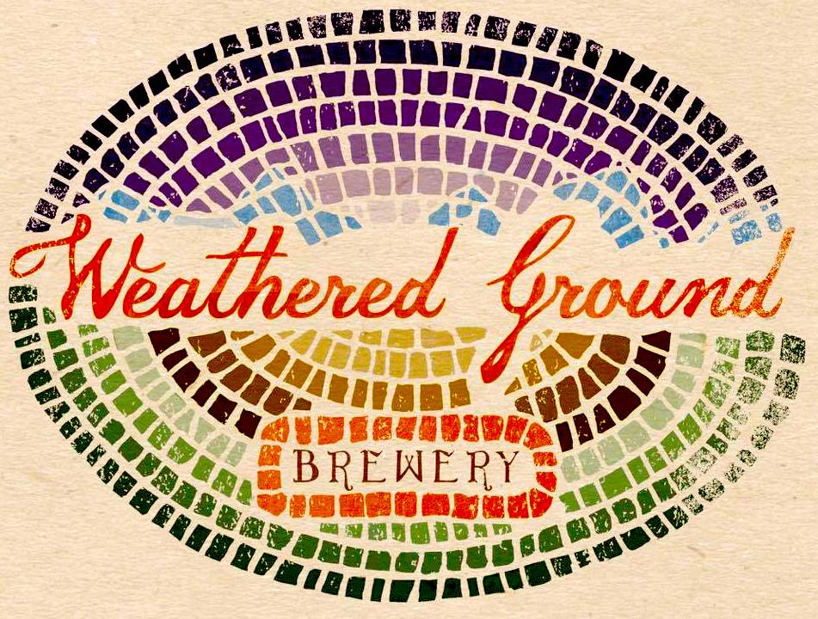

Slide 24
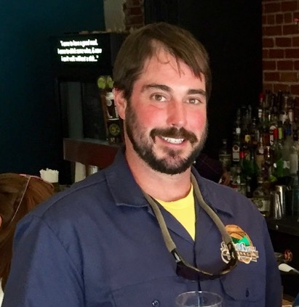
Nathan Herrold • Bridge Brew Works

Slide 25
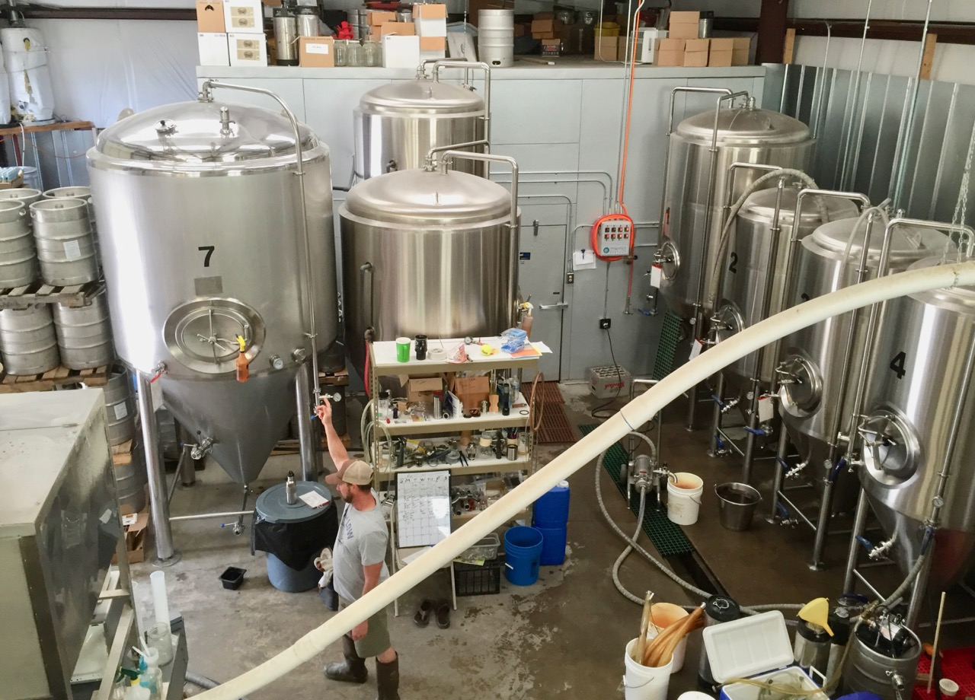
Bridge Brew Works

Slide 26
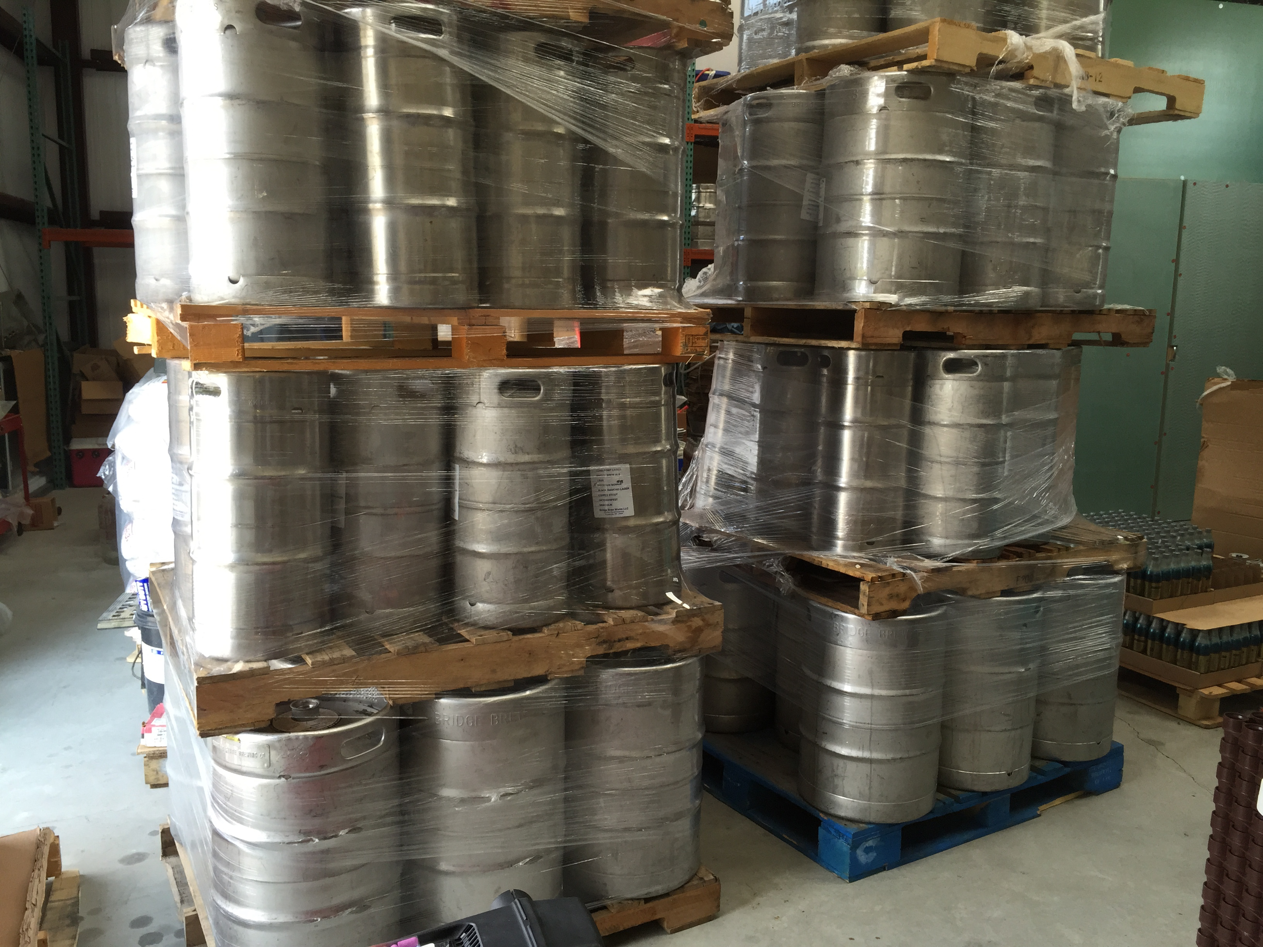
Bridge Brew Works

Slide 27
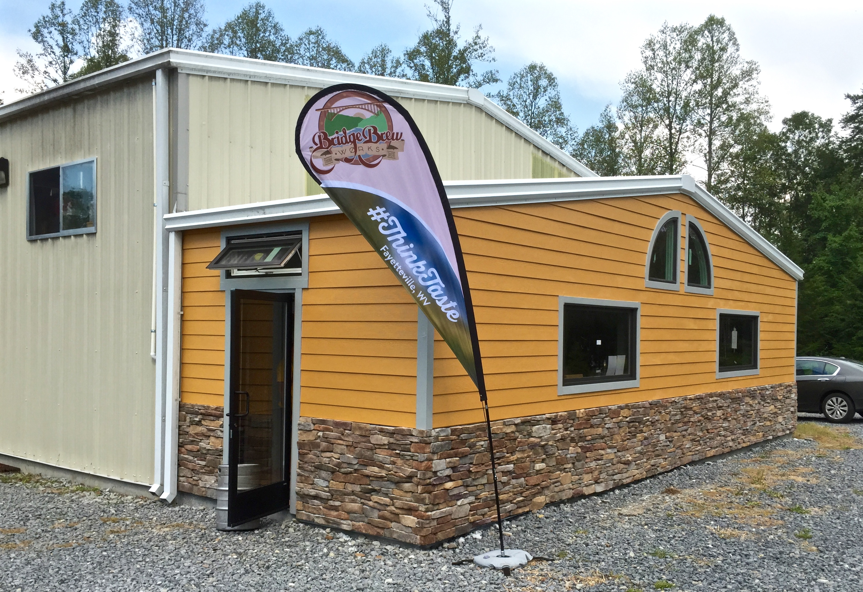
Bridge Brew Works

Slide 28
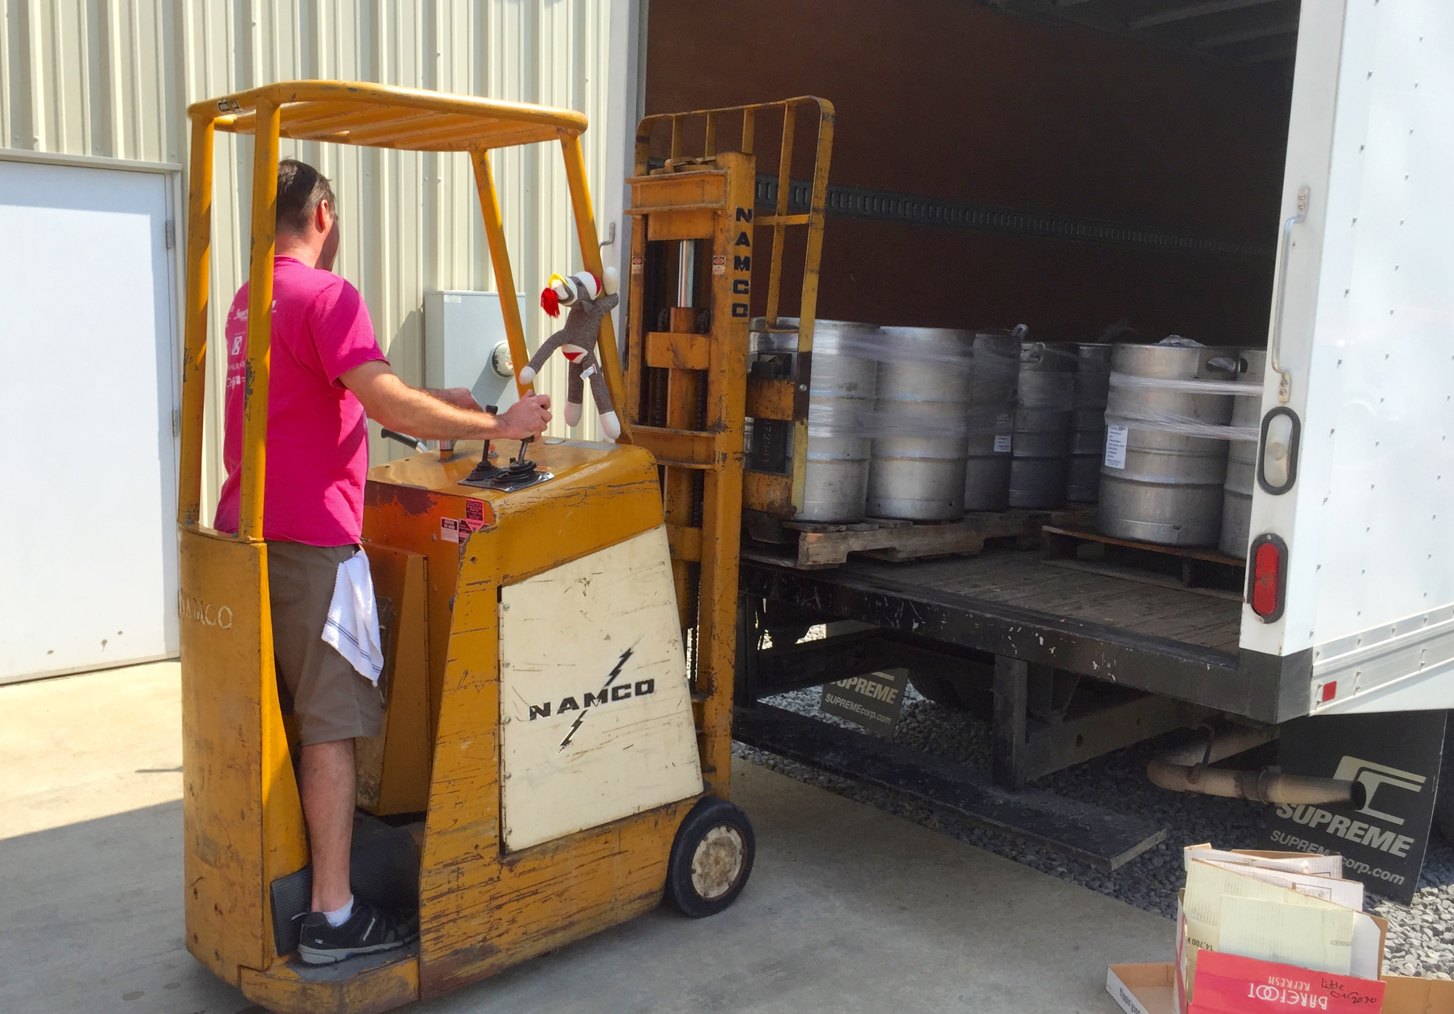
Bridge Brew Works

Slide 29
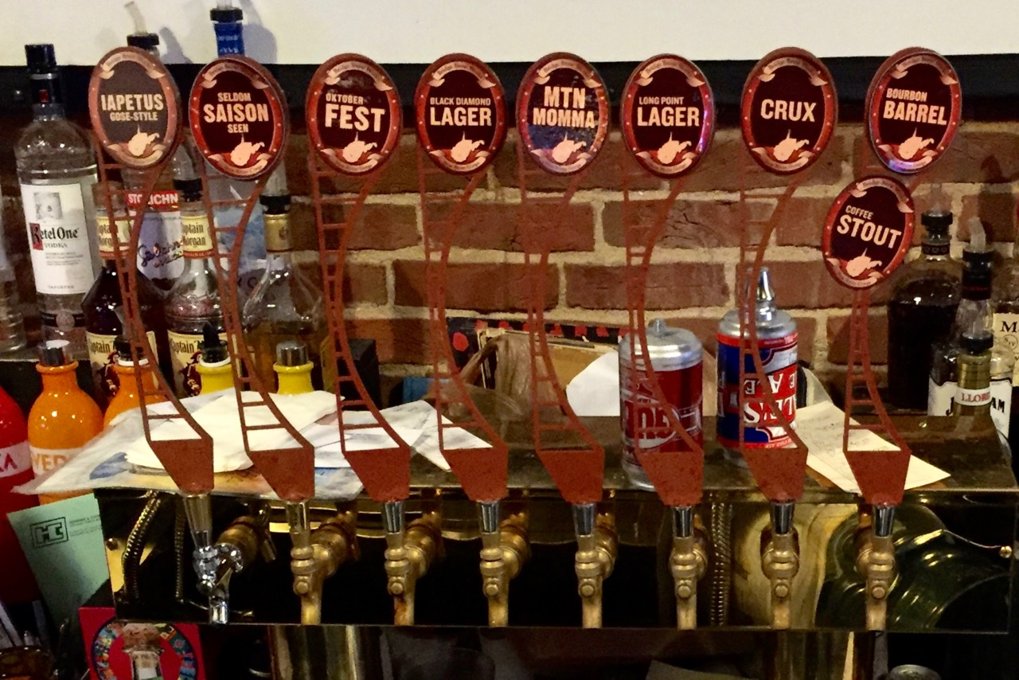
Bridge Brew Works

Slide 30
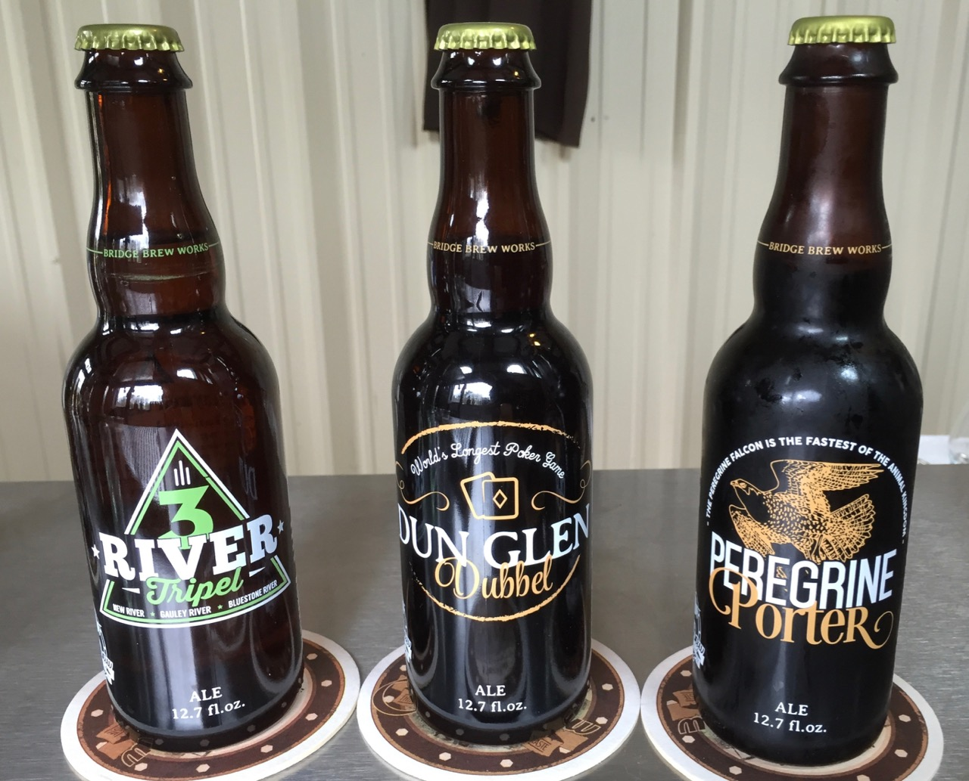
Bridge Brew Works

Slide 31
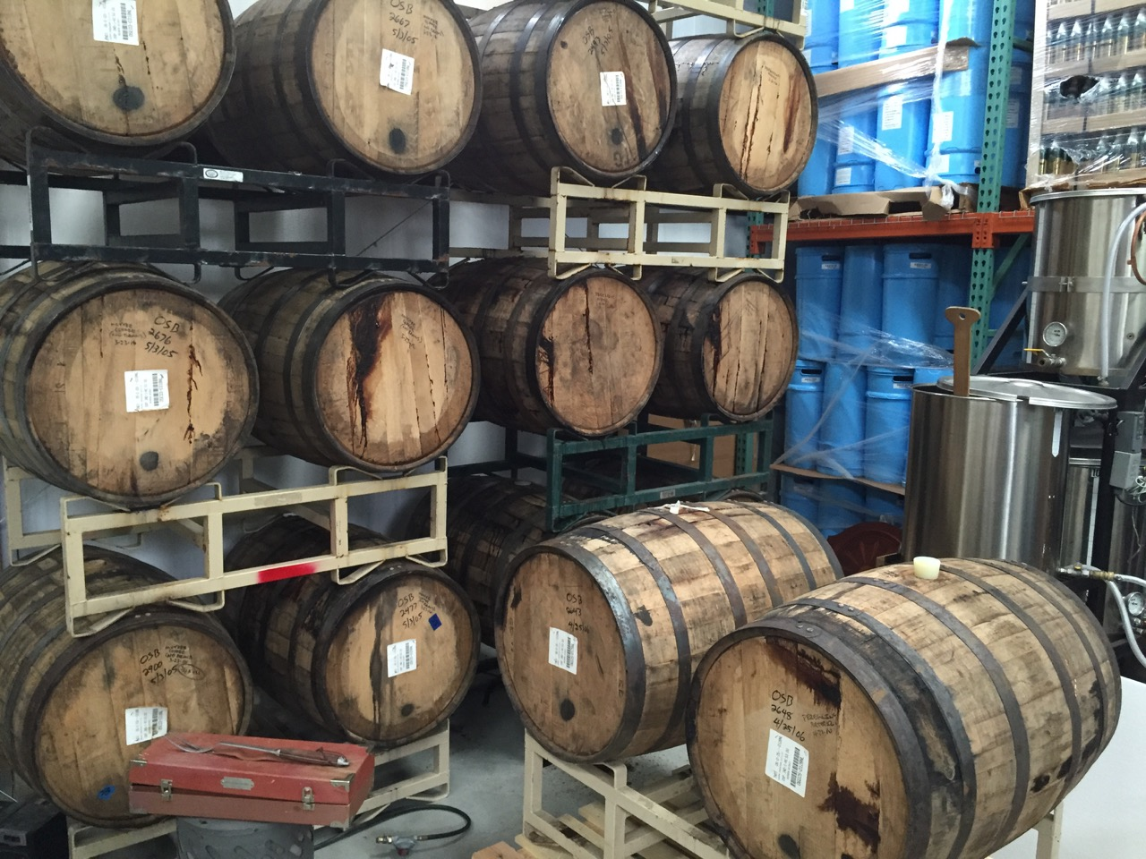
Bridge Brew Works

Slide 32
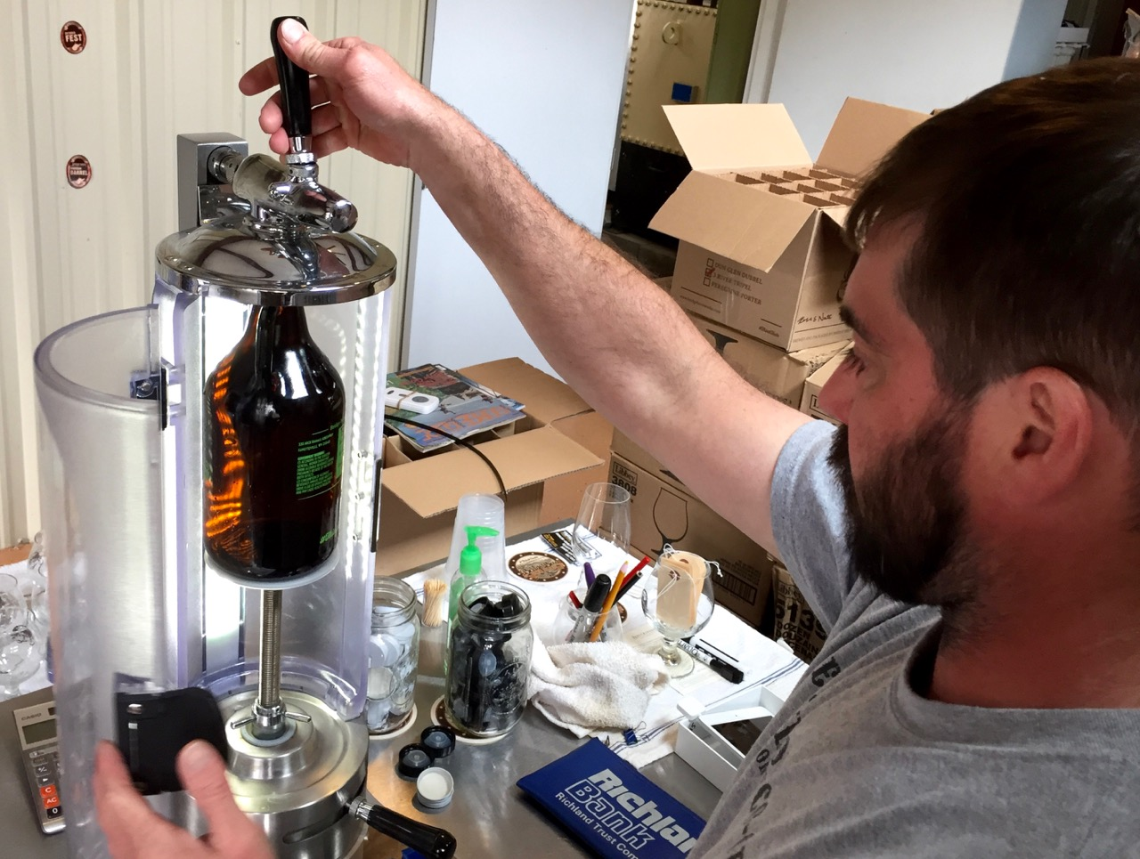
Bridge Brew Works

Slide 33
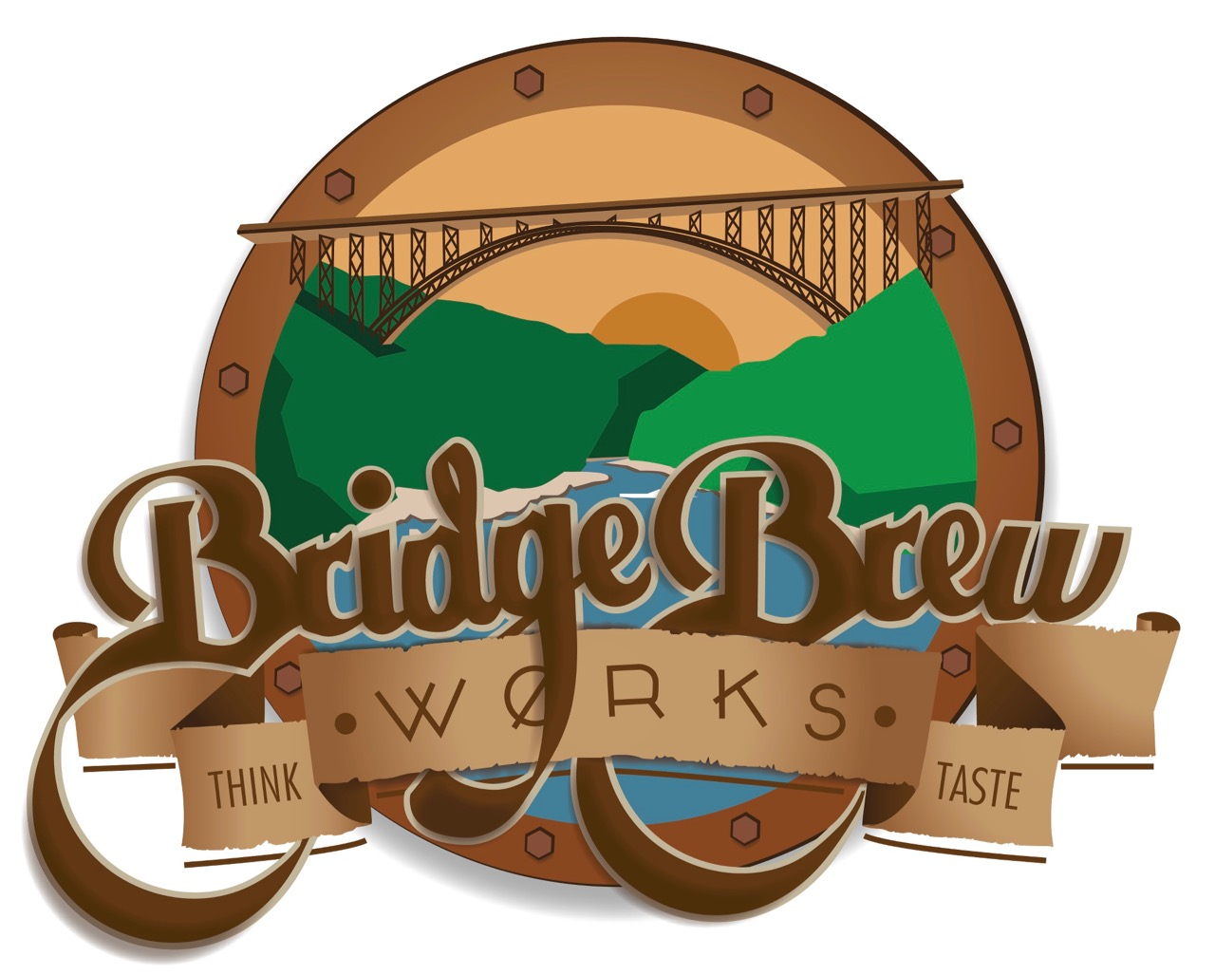

Slide 34
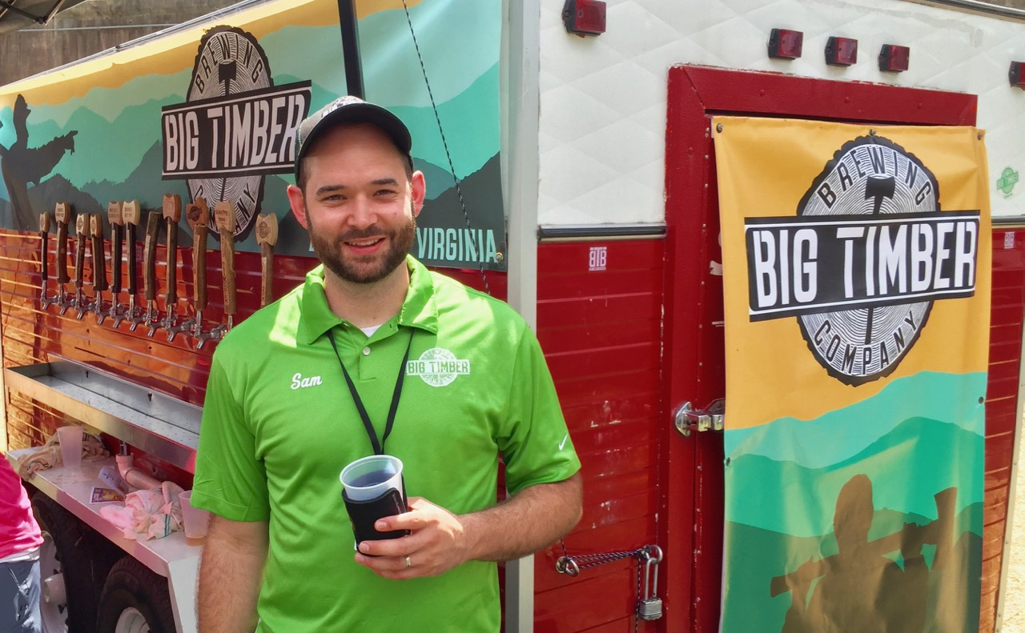
Sam Mauzy • Big Timber Brewing

Slide 35
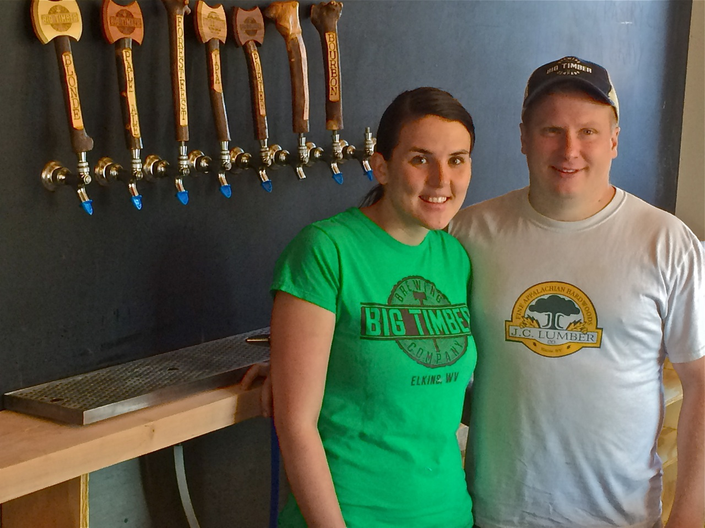
Ashley & Matt Kwasniewski • Big Timber Brewing

Slide 36
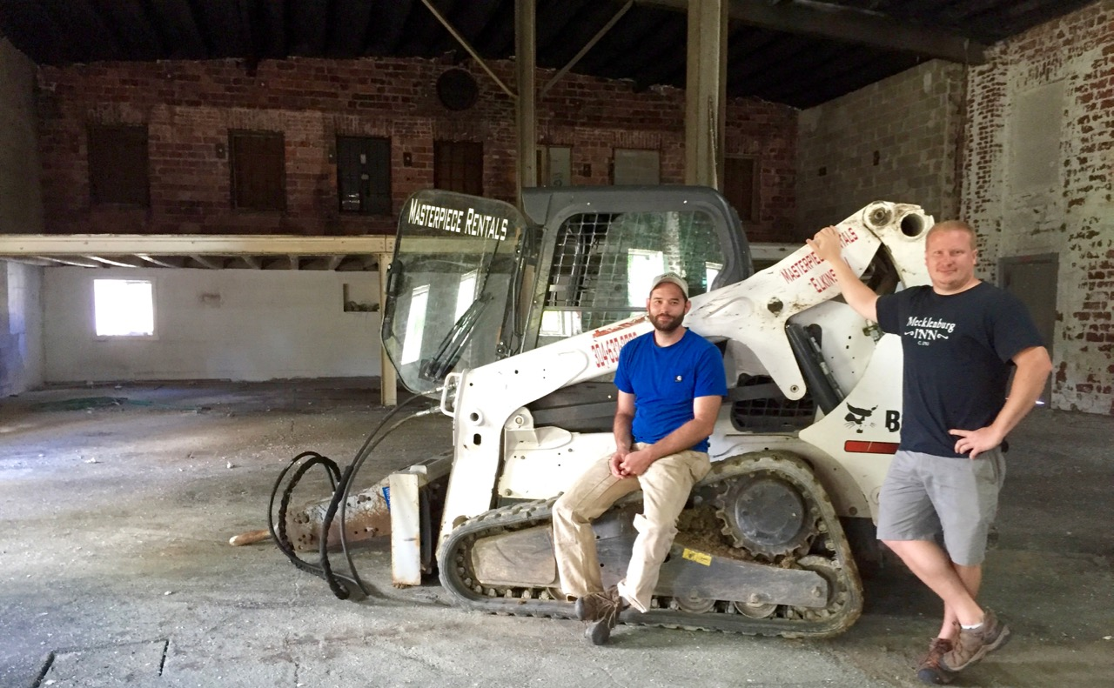
big timber brewing

Slide 37
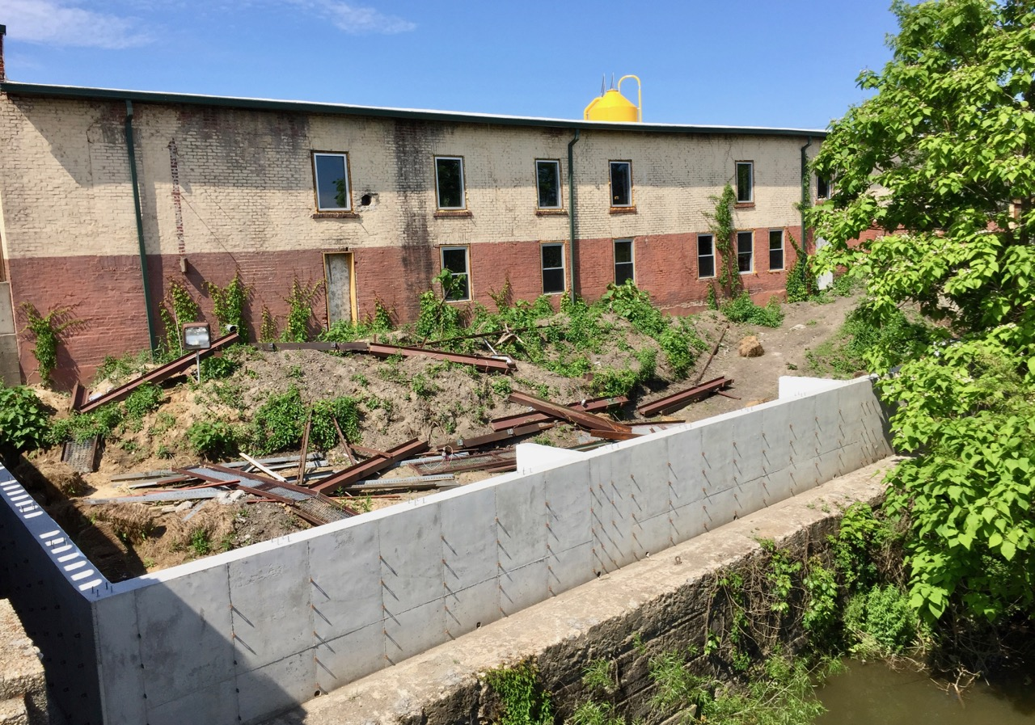
big timber brewing
New brewery building undergoing redevelopment

Slide 38
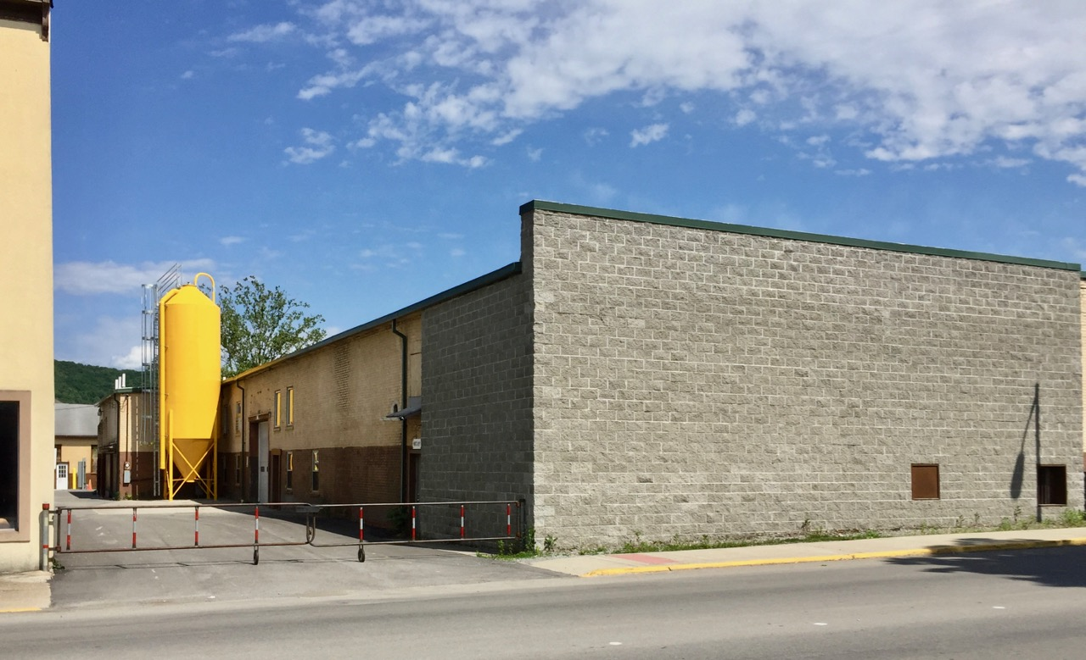
Big timber Brewing
New brewery building undergoing redevelopment

Slide 39
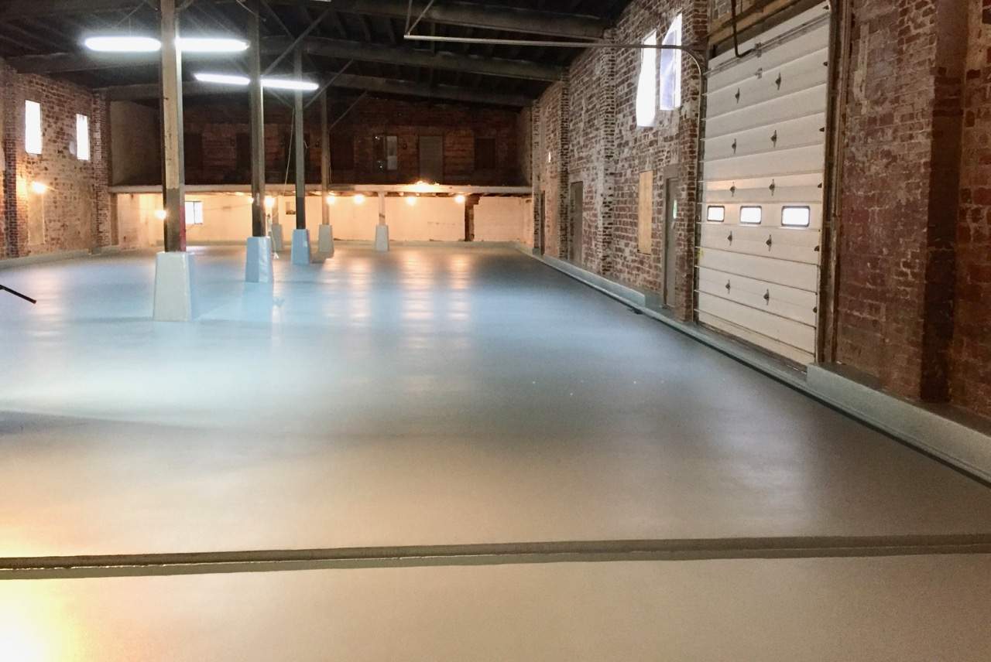
big timber brewing

Slide 40
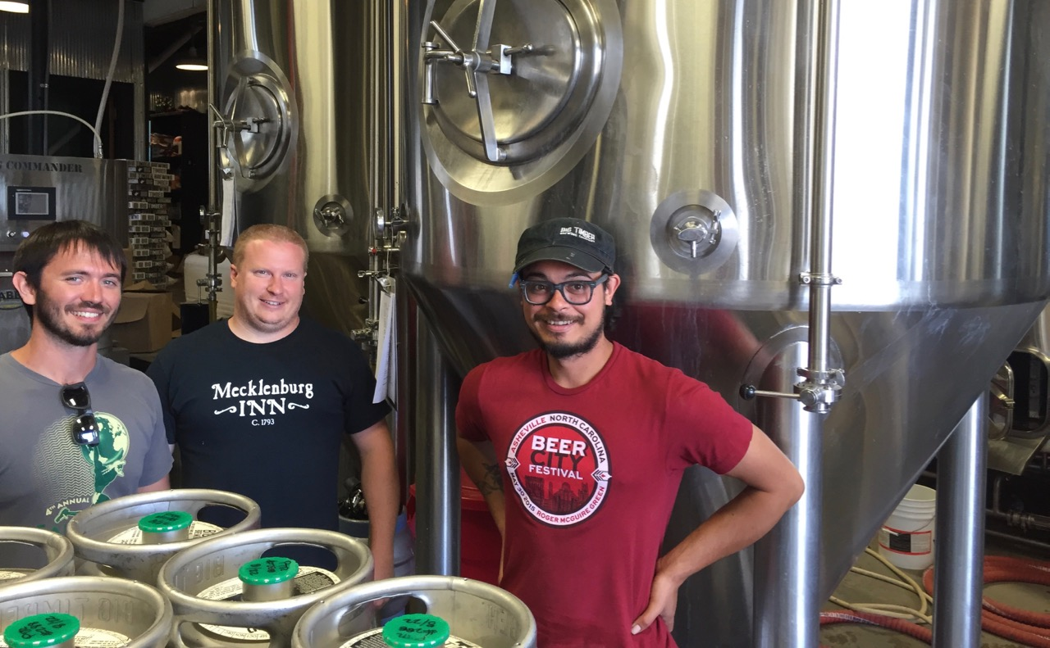
Big Timber Brewing

Slide 41
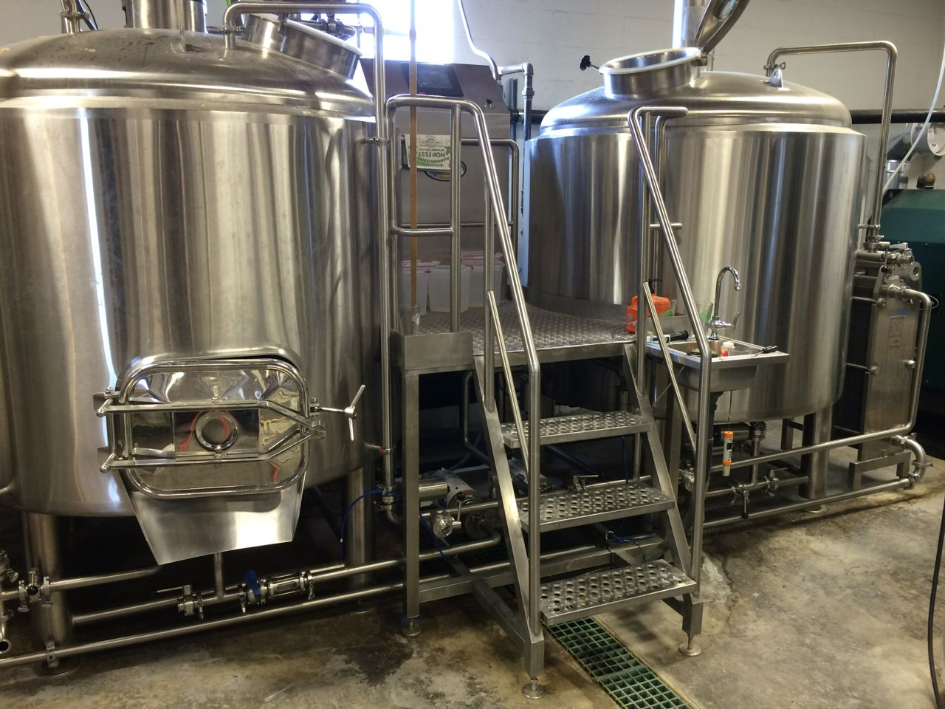
big timber brewing

Slide 42
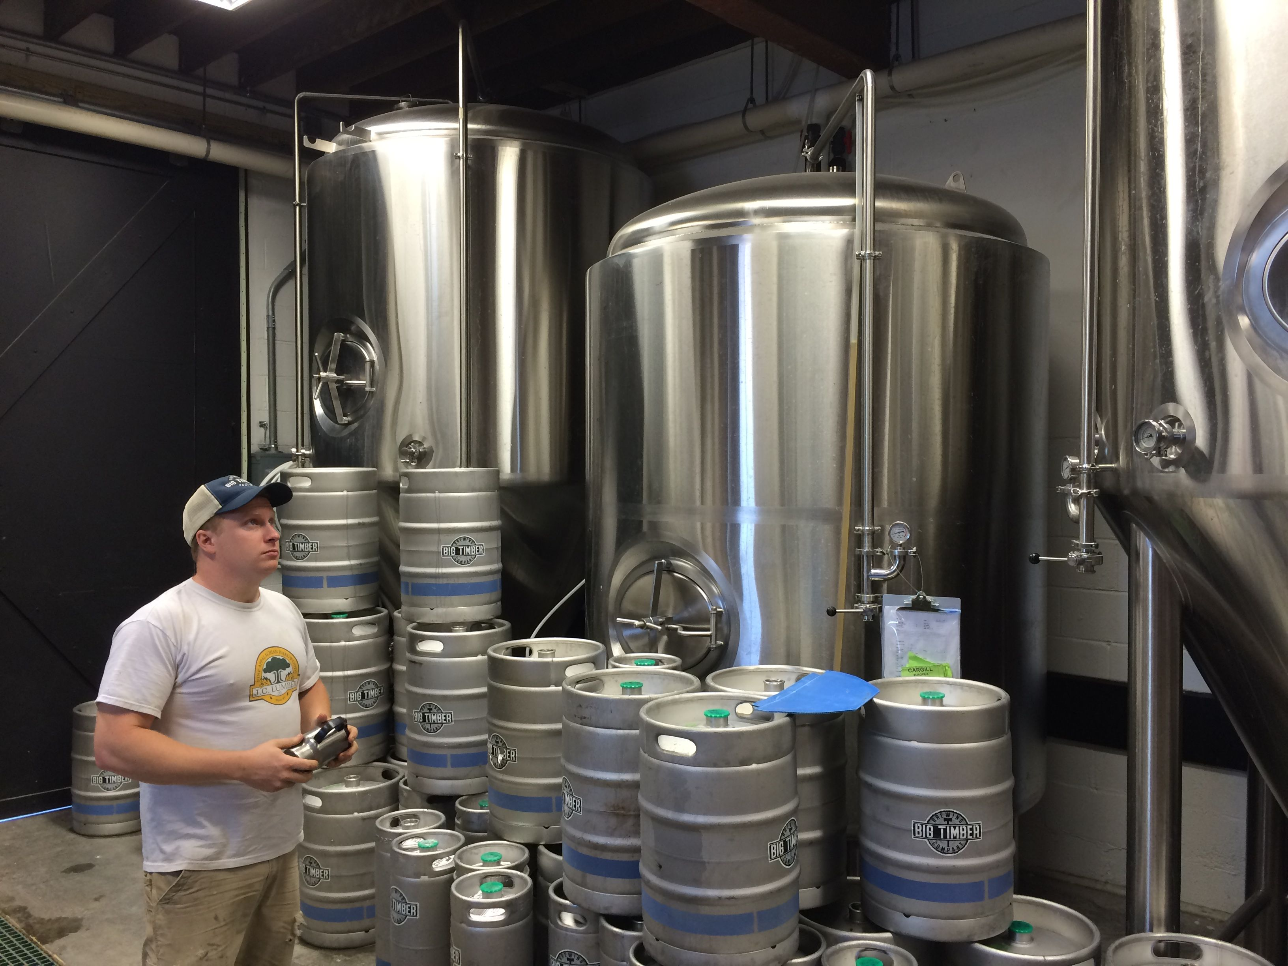
big timber brewing

Slide 43
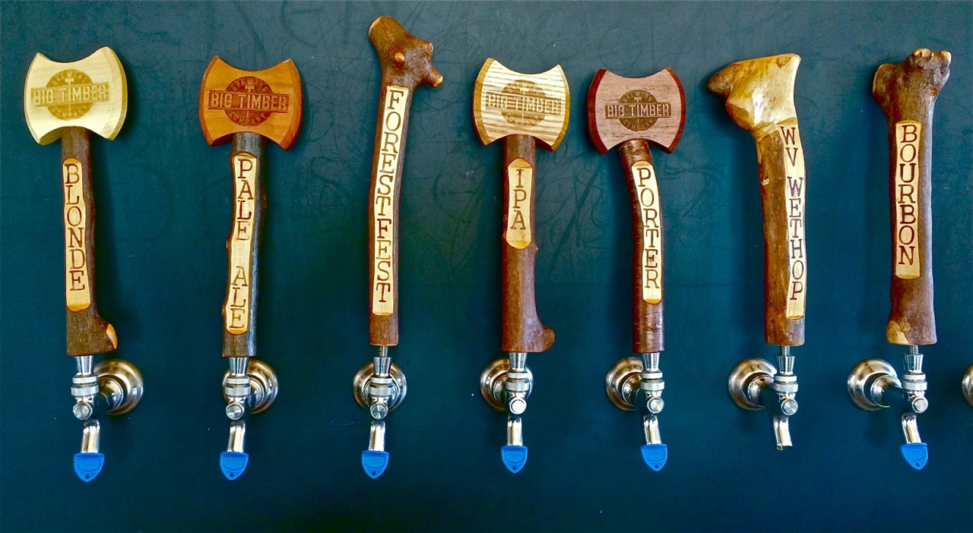
Big Timber Brewing

Slide 44
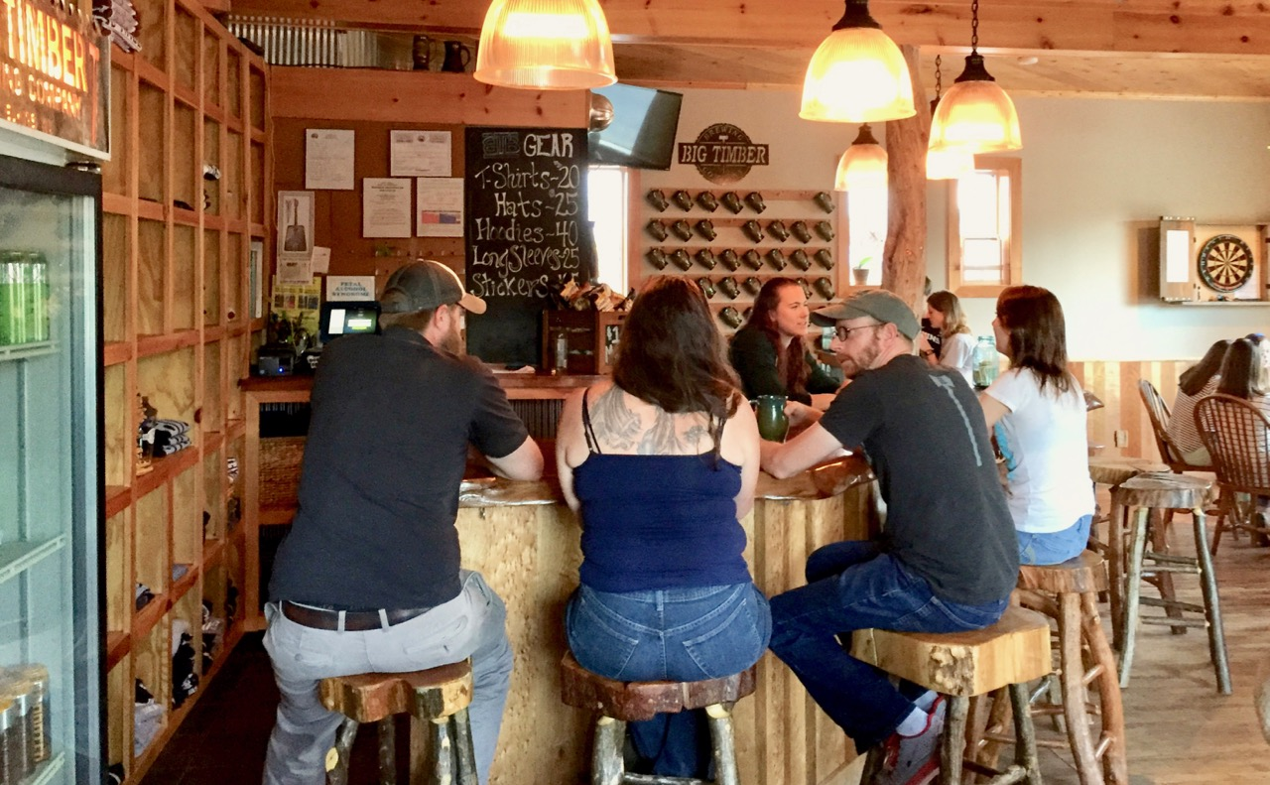
Big timber brewing

Slide 45
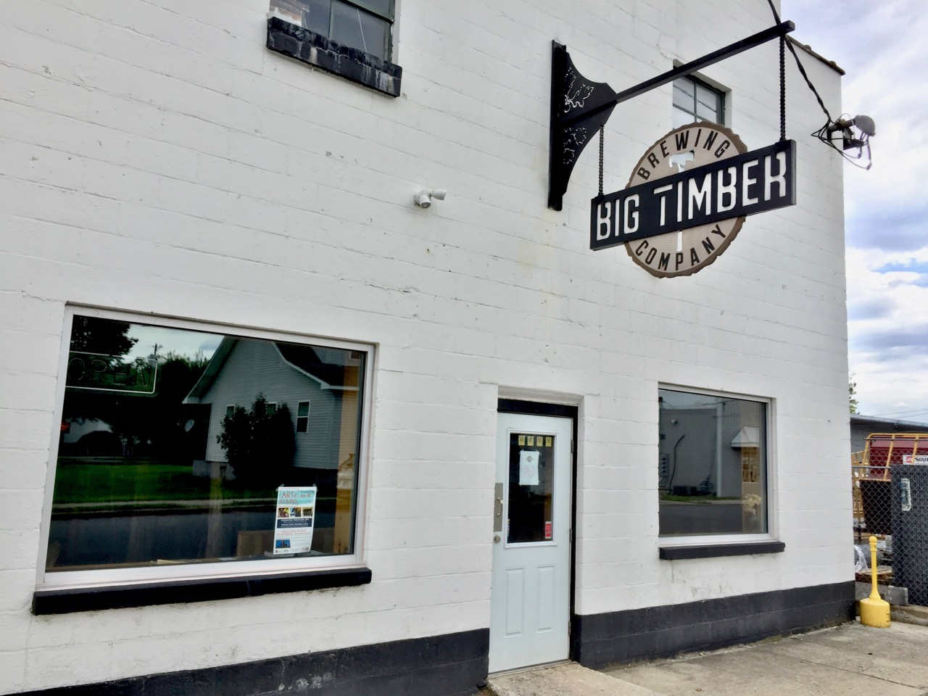
big timber brewing

Slide 46
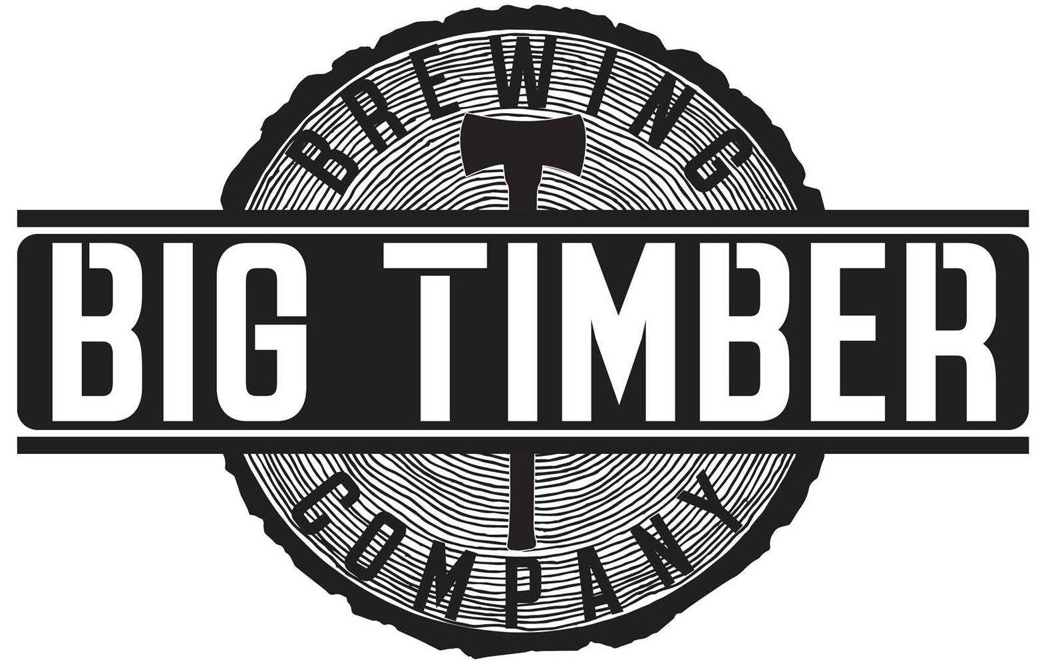

Slide 47
poised for growth
BrilliantStream.com
West Virginia Brewing Industry

Slide 48
prime areas for brewery development
WV Brewing Industry
Charleston (1 brewery)
Huntington (1 brewery)
Clarksburg–Bridgeport (0 breweries)
Martinsburg (0 breweries)

Slide 49
Growth potential in Charleston–Huntington
WV brewing industry
Charleston–Huntington Primary Statistical Area (PSA) contained 698,809 people, ranking it the 79th largest PSA out of the 569 PSAs in the nation. (2014)
Charleston-Huntington has 2 breweries
Huntsville, Alabama, the 80th largest PSA, has 8 breweries.
Springfield, Massachusetts, the 78th largest PSA, has 13 breweries.

